Slide 1
BBM-382 – SOFTWARE ENGINEERING
SPRING 2018
Lecture 6
Dr. Ayça TARHAN

Slide 2
Chapter 6 – Architectural Design

Slide 3
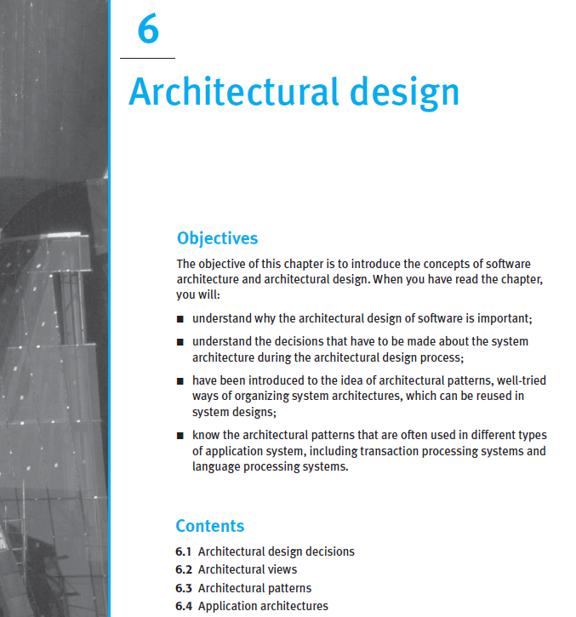
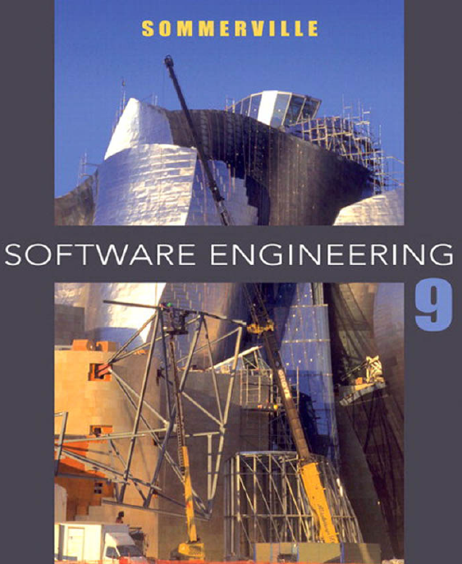
From the book
Read it online!

Slide 4
Chapter 6-Topics covered
Review of OO and class diagrams (basics of SW architecture)
On overview of Architectural design
Architectural views
Architectural patterns
Application architectures

Slide 5
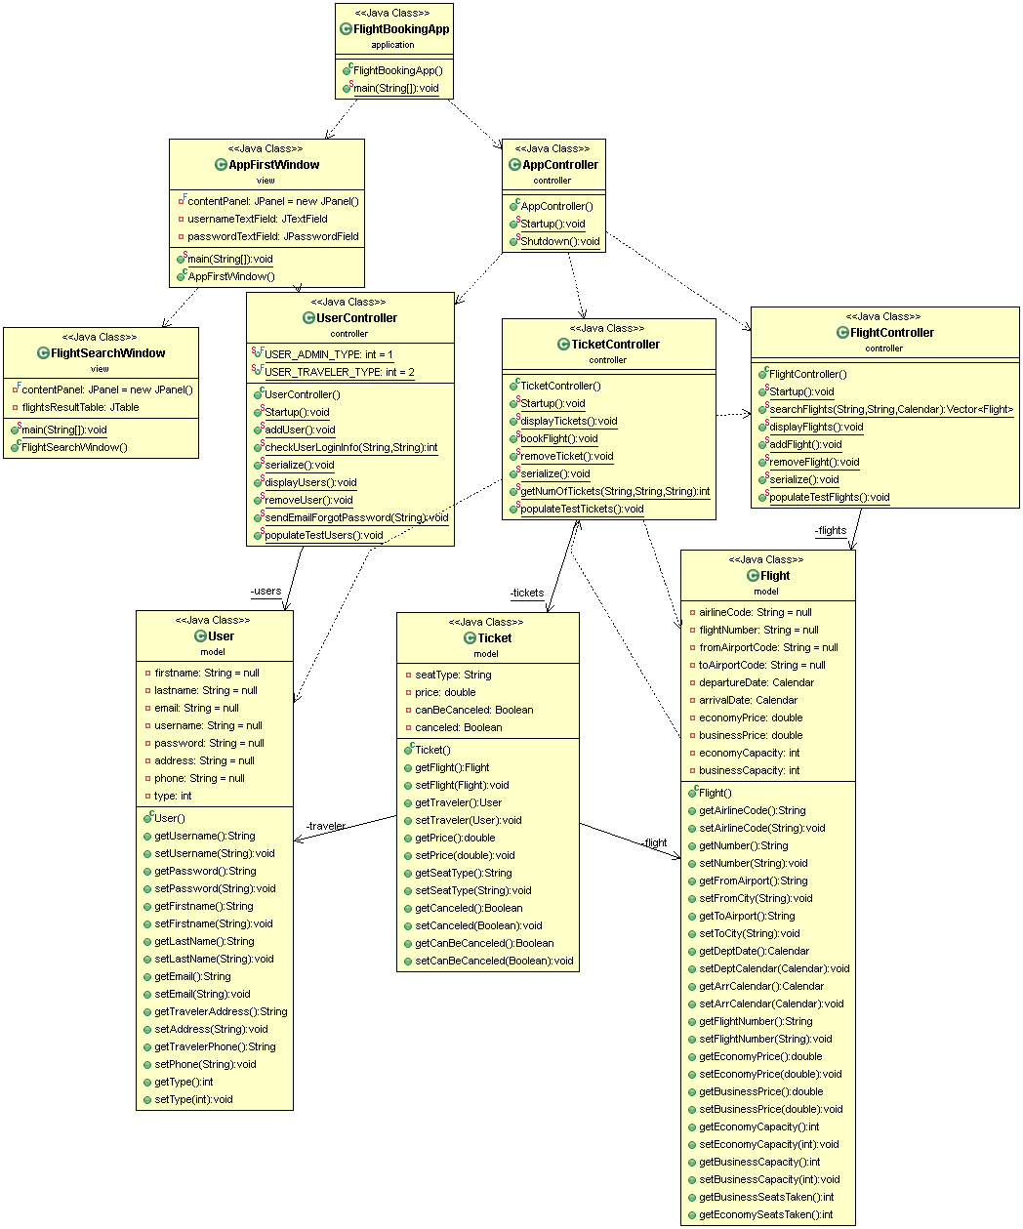
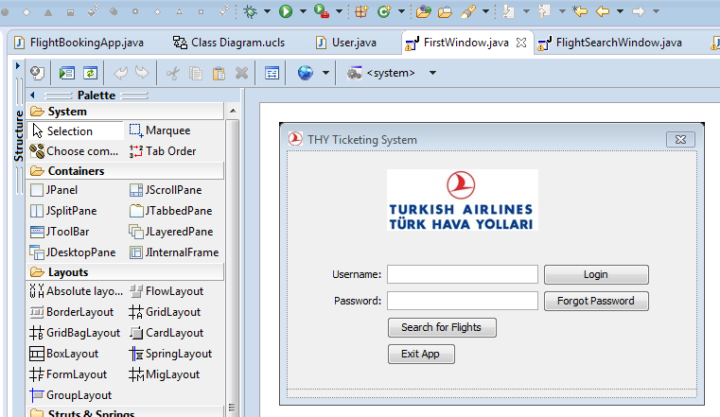
Class diagrams (zoomed next…)

Slide 6
Class diagrams

Slide 7
Class diagrams

Slide 8

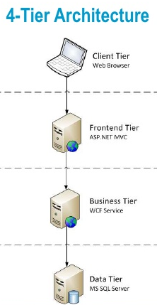

From Class diagrams to SW architecture
Architectural “layers” (tiers)

Slide 9
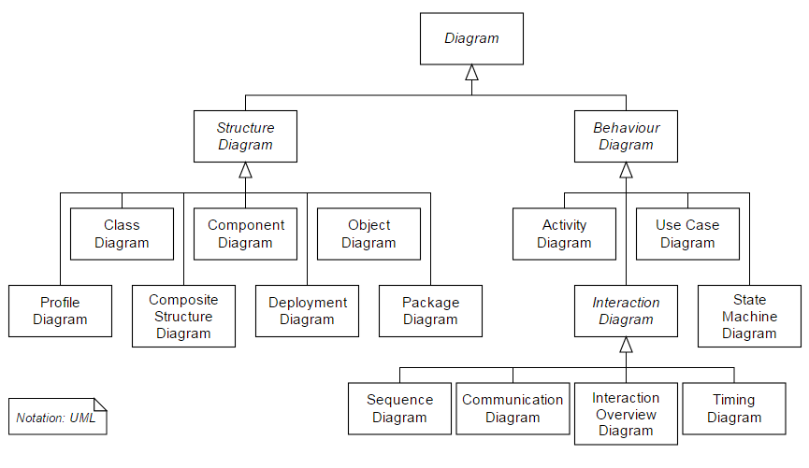
Showing SW architecture in UML
14 diagrams in total
Ch. 5
Ch. 5
Ch. 6

Slide 10
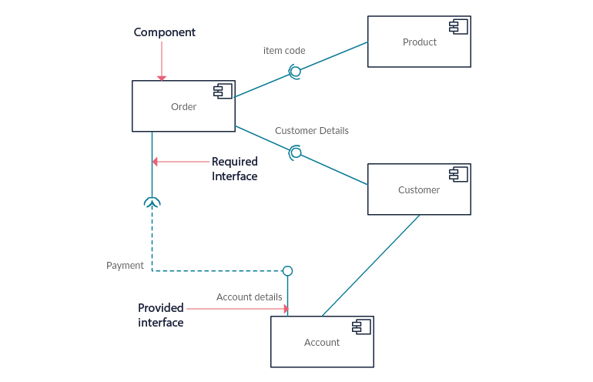
UML Component Diagram - Example
https://creately.com/blog/diagrams/uml-diagram-types-examples/

Slide 11
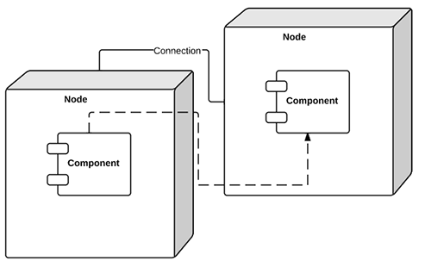
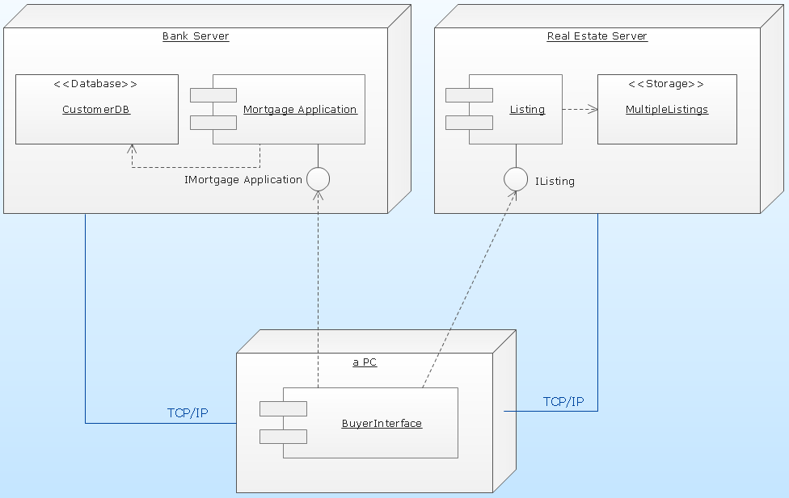
UML Deployment Diagram: Example
http://www.conceptdraw.com/How-To-Guide/uml-deployment-diagram

Slide 12
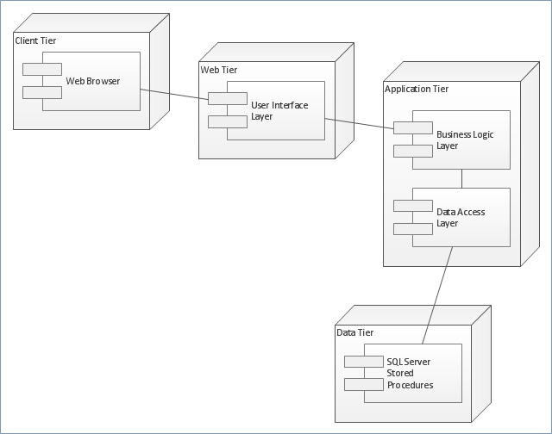
UML Deployment Diagram: 4-Tier Architecture
https://conceptdraw.com/a661c3/preview--UML%20deployment%20diagram%20template

Slide 13
Chapter 6-Topics covered
Review of OO and class diagrams
On overview of Architectural design
Architectural views
Architectural patterns
Application architectures

Slide 14
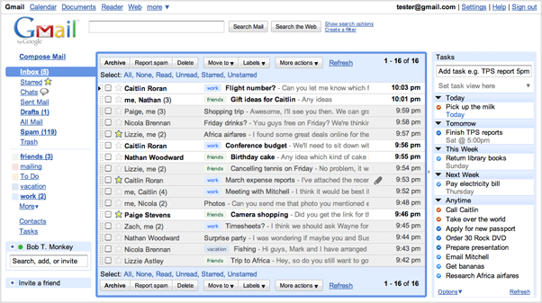
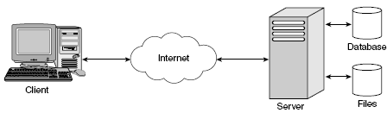
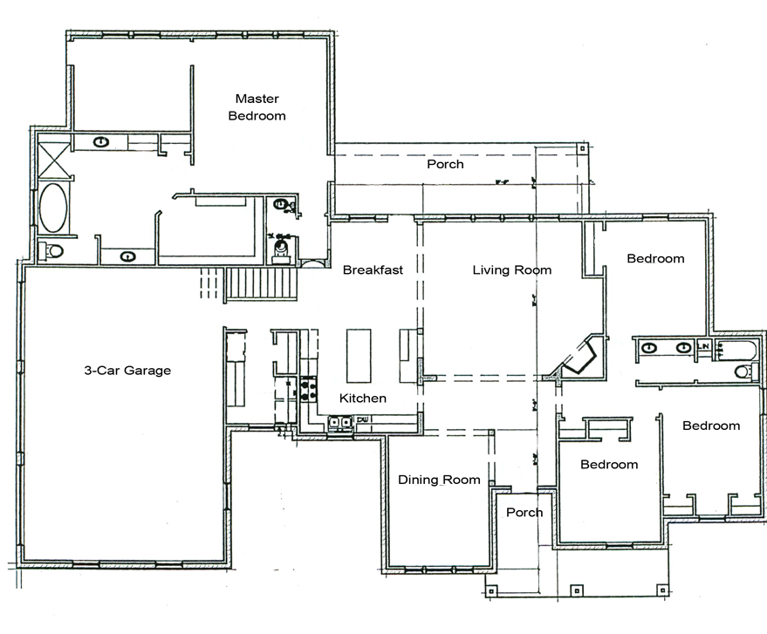
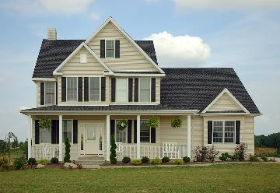
Software architecture versus ‘regular’ architecture

Slide 15
Software architecture
The design process for identifying the major system components making up a system and their control and communication is architectural design.
An early stage of the design process - Represents the link between specification and design processes.
Often carried out in parallel with some specification activities.
The output of this design process is a description of the system/software architecture.
Note that sub-system = component = module in this context.

Slide 16
A general model of the design process (Ch. 2)
The diagram suggests that the stages of the design process are sequential.
In fact, design process activities are interleaved. Feedback from one stage to another and consequent design rework is inevitable in all design processes.

Slide 17
Design activities (Ch.2)
Architectural design, where you identify the overall structure of the system, the principal components (sometimes called sub-systems or modules), their relationships and how they are distributed.
Interface design, interfaces between system components.
Component design, you take each system component and design how it will operate.
Database design, you design the system data structures and how these are to be represented in a database.

Slide 18
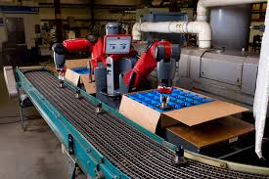
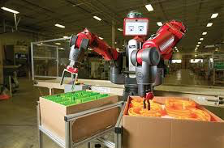
The architecture of a packing robot control system
Architectural Design identifies
the major system components
making up a system and
their control and communication.
https://www.youtube.com/watch?v=cf7M4XnIzU8

Slide 19
Architectural abstraction
Architecture in the small is concerned with the architecture of individual programs.
At this level, we are concerned with the way that an individual program is decomposed into components.
Architecture in the large is concerned with the architecture of complex enterprise systems that include other systems, programs, and program components.
These enterprise systems are distributed over different computers, which may be owned and managed by different companies.

Slide 20
Architectural representations
Simple, informal block diagrams showing entities and relationships are the most frequently used method for documenting software architectures.
criticized to be very abstract because they lack semantics, do not show the types of relationships between entities nor the visible properties of entities in the architecture.
However, useful for communication with stakeholders and for project planning.

Slide 21
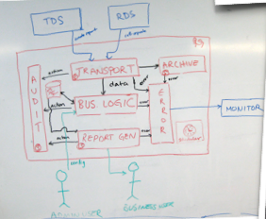
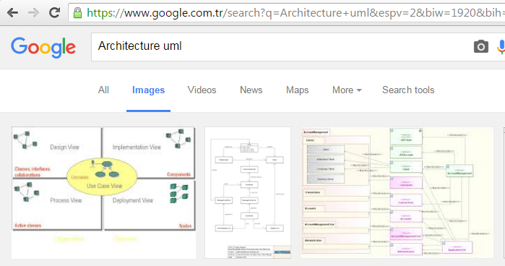
Architectural representations
By hand
Using software tools

Slide 22
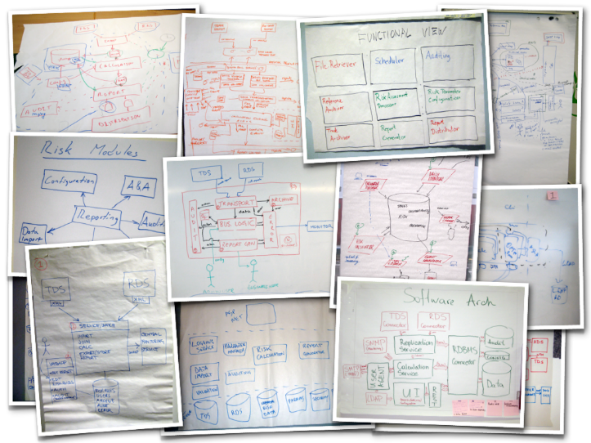
Architectural representations
By hand

Slide 23
Architectural design decisions
Architectural design is a creative process so the process differs depending on the type of system being developed.
However, a number of common decisions span all design processes and these decisions affect the non-functional characteristics of the system.
Is there a generic application architecture that can be used?
How will the system be distributed?
What architectural styles are appropriate?
What approach will be used to structure the system?
How will the system be decomposed into modules?
What control strategy should be used?
How will the architectural design be evaluated?
How should the architecture be documented?

Slide 24
Architecture and system characteristics
Performance
Localize critical operations and minimize communications.
Security
Use a layered architecture with critical assets in the inner layers.
Safety
Localize safety-critical features in a small number of sub-systems.

Slide 25
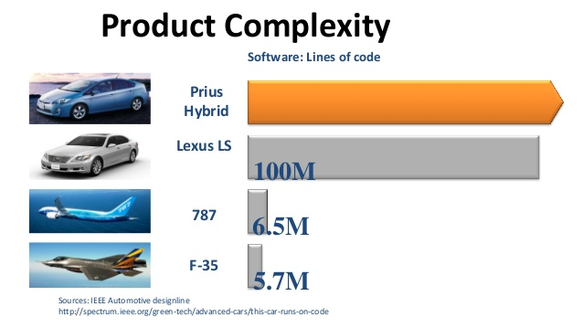
Software in automotive and aviation

Slide 26

Automotive software

Slide 27
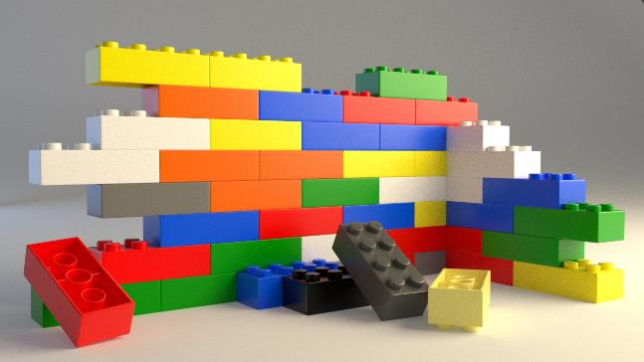
Architecture and system characteristics
Availability
Include redundant components and mechanisms for fault tolerance.
Maintainability
Use fine-grain, replaceable components.

Slide 28
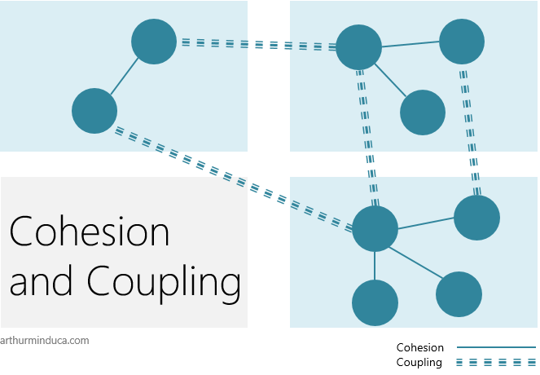
An important topic in software architecture: Cohesion and Coupling
Cohesion is the degree to which the elements in a design unit (package, class etc.) are logically related, or "belong together".
Coupling is the degree to which the elements in a design are connected.

Slide 29
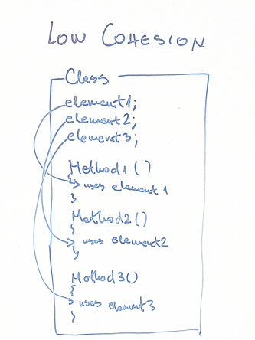
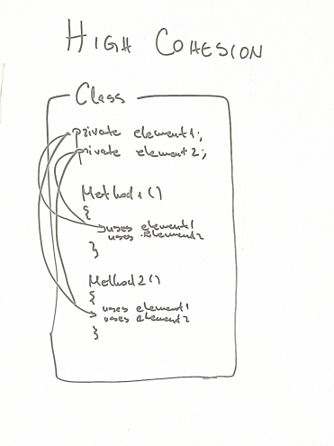
Cohesion and Coupling: examples from code
Coincidental cohesion is when parts of a module are grouped arbitrarily; the only relationship between the parts is that they have been grouped together.
Functional cohesion is when parts of a module are grouped because they all contribute to a single well-defined task of the module
https://thebojan.ninja/2015/04/08/high-cohesion-loose-coupling/

Slide 30
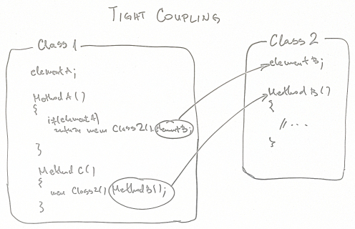

Cohesion and Coupling: examples from code
https://thebojan.ninja/2015/04/08/high-cohesion-loose-coupling/

Slide 31
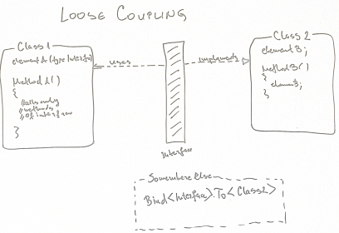

Cohesion and Coupling: examples from code
https://thebojan.ninja/2015/04/08/high-cohesion-loose-coupling/

Slide 32
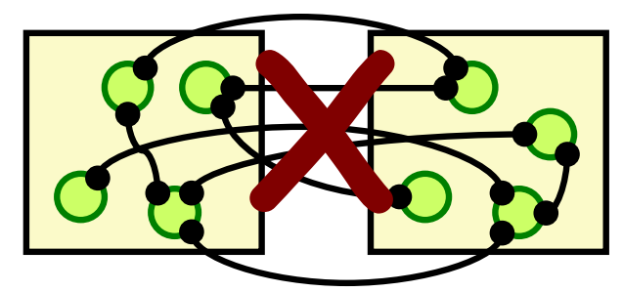
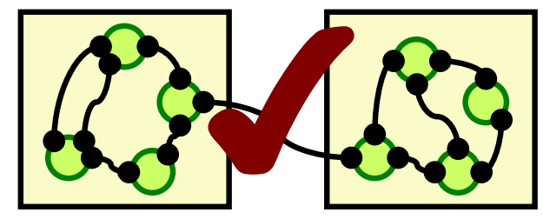
Cohesion and Coupling
A good architecture:
Maximizes the cohesion of each module
Goal: the contents of each module are strongly inter-related
High cohesion means the subcomponents really do belong together
Minimizes coupling between modules:
Goal: modules donʼt need to know much about one another to interact
Low coupling makes future change easier

Slide 33
Cohesion and Coupling
Conwayʼs Law:
“The structure of a software system reflects the structure of the organisation that built it”
"Bir yazılım sisteminin yapısı onun inşa eden firmanın yapısını yansıtır"

Slide 34
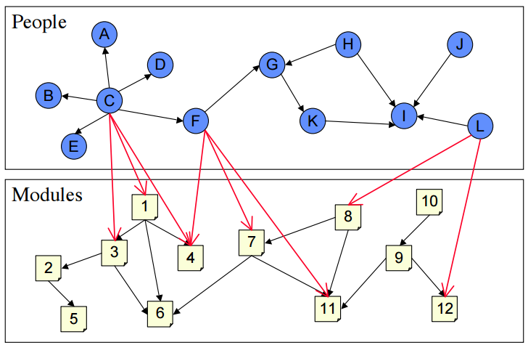
Cohesion and Coupling
Correspondence of socio-technical relationship and dependencies

Slide 35
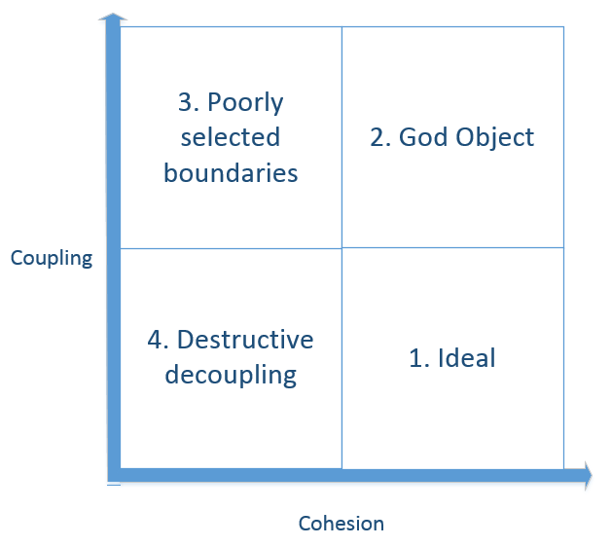
Cohesion and Coupling
Goal is to: Maximize Cohesion and Minimize coupling

Slide 36
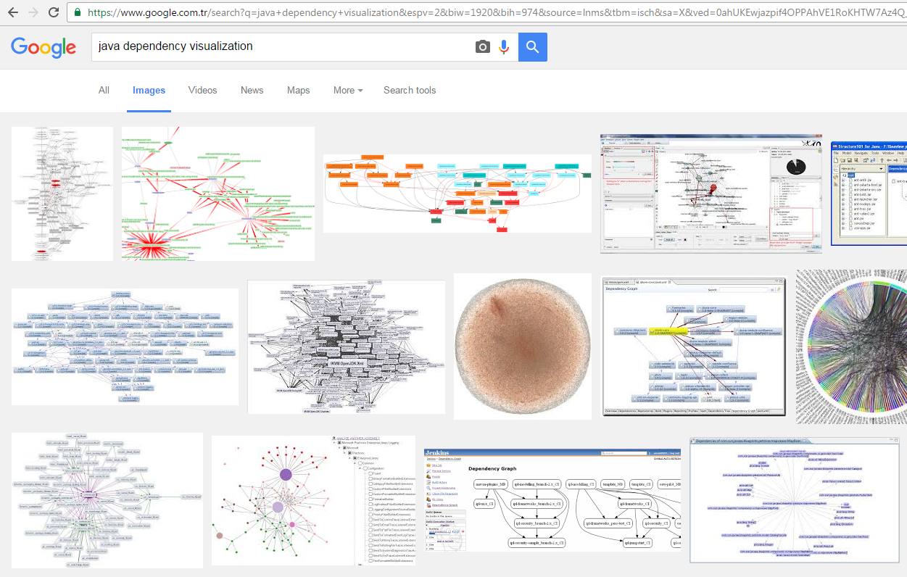
Cohesion and Coupling: Tools
There are many tools to do “dependency analysis”

Slide 37
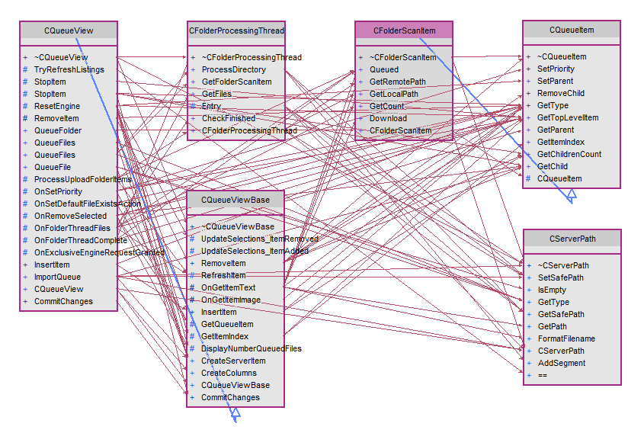
Cohesion and Coupling: Tools
There are many tools to do “dependency analysis”

Slide 38
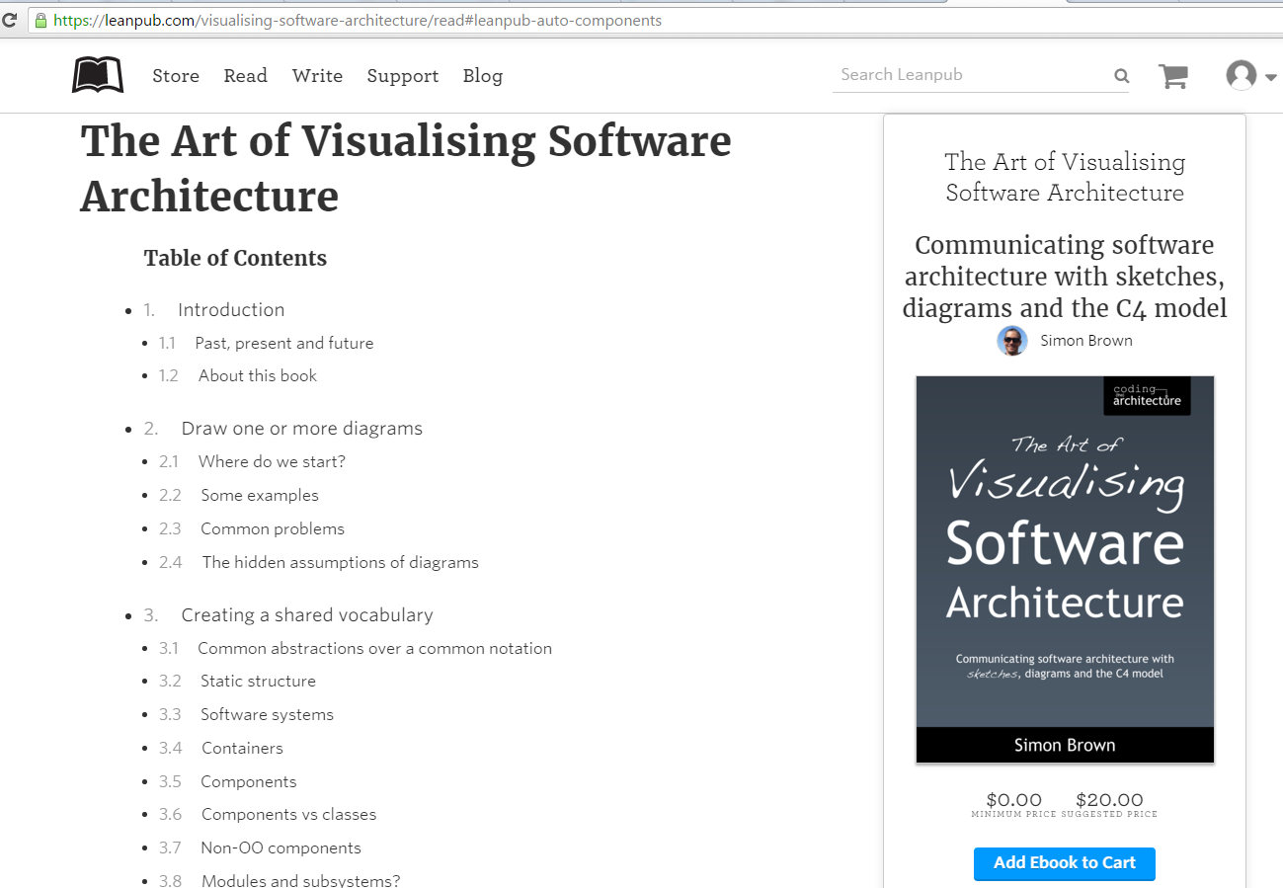
A good book on SW architecture
https://leanpub.com/visualising-software-architecture/read

Slide 39
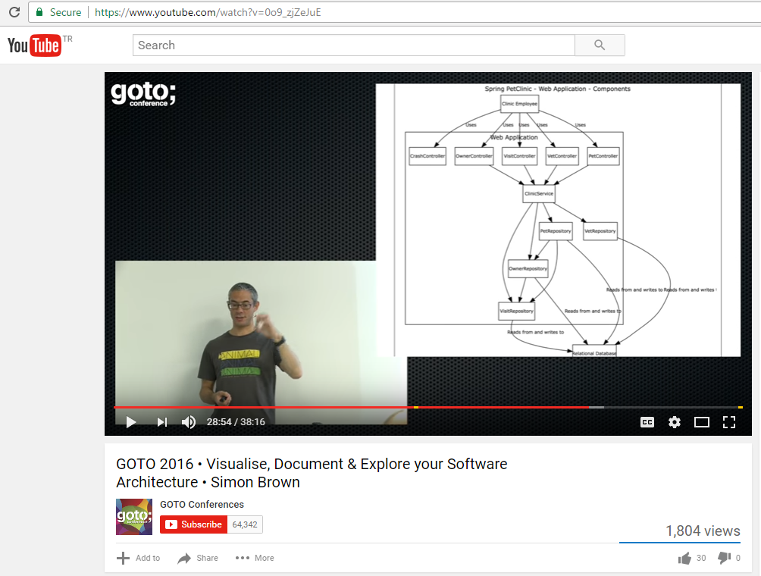
Let’s watch now!
https://www.youtube.com/watch?v=0o9_zjZeJuE
38 minutes

Slide 40
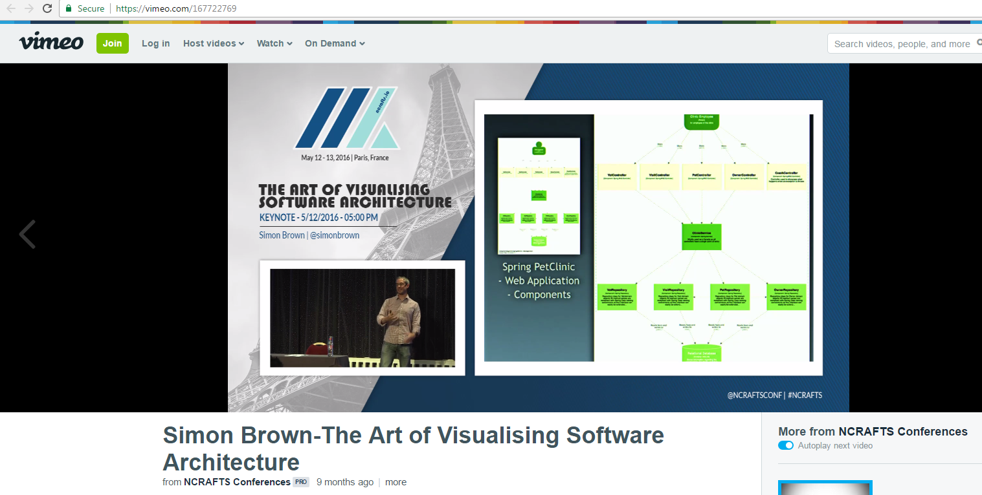
Watch later
https://vimeo.com/167722769

Slide 41
Chapter 6-Topics covered
On overview of Architectural design
Architectural views
Architectural patterns
Application architectures

Slide 42
Architectural views
What views or perspectives are useful when designing and documenting a system’s architecture?
What notations should be used for describing architectural models?
Each architectural model only shows one view or perspective of the system.
It might show how a system is decomposed into modules, how the run-time processes interact or the different ways in which system components are distributed across a network.

Slide 43
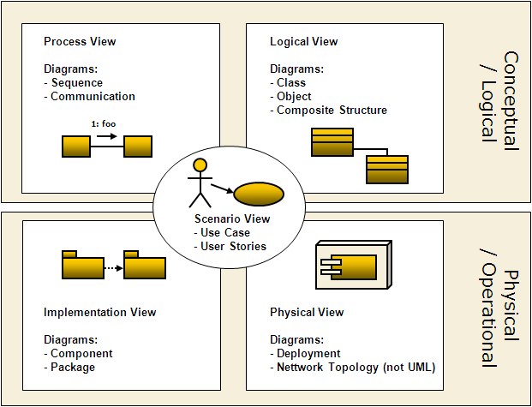
4 + 1 view model of software architecture (introduced by Philippe Kruchten)
https://www.researchgate.net/publication/238381956_A_41_View_Model_of_Software_Architecture

Slide 44
4 + 1 view model of software architecture
For both design and documentation, you usually need to present multiple views of the software architecture:
A logical view, which shows the key abstractions in the system as objects or object classes.
A process view, which shows how, at run-time, the system is composed of interacting processes.
A development view, which shows how the software is decomposed for development.
A physical view, which shows the system hardware and how software components are distributed across the processors in the system.
Related use cases or scenarios (+1)

Slide 45
Chapter 6-Topics covered
On overview of Architectural design
Architectural views
Architectural patterns
Application architectures

Slide 46
Architectural patterns
In software engineering, a pattern is a general repeatable solution to a commonly occurring problem in software engineering.
Patterns are a means of representing, sharing and reusing knowledge.
There are different types of pattern in SW engg:
Architectural patterns
Design patterns
Test patterns
Performance patterns

Slide 47
Architectural patterns
An architectural pattern is a stylized description of good design practice, which has been tried and tested in different environments.
Patterns should include information about when they are and when they are not useful.
Patterns may be represented using tabular and graphical descriptions.
Review of several Architectural patterns:
1 - Model-View-Controller (MVC) pattern
2 - Layered architecture pattern
3 - Repository architecture pattern
4 - Client-server architecture pattern
5 - Pipe and filter architecture pattern

Slide 48
1 - Model-View-Controller (MVC) pattern
Name | MVC (Model-View-Controller)
Description | Separates presentation and interaction from the system data. The system is structured into three logical components that interact with each other. Model component manages data and associated operations on that data. View component defines and manages how data is presented to user. Controller component manages user interaction (e.g., key presses, mouse clicks, etc.) and passes these interactions to View and Model. See Figure 6.3.
Example | Figure 6.4 shows the architecture of a web-based application system organized using the MVC pattern.
When used | Used when there are multiple ways to view and interact with data. Also used when the future requirements for interaction and presentation of data are unknown.
Advantages | Allows data to change independently of its representation and vice versa. Supports presentation of the same data in different ways with changes made in one representation shown in all of them.
Disadvantages | Can involve additional code and code complexity when data model and interactions are simple.

Slide 49
The organization of the Model-View-Controller

Slide 50
Web application architecture using the MVC pattern

Slide 51
2 - Layered architecture pattern

Slide 52
2 - Layered architecture pattern
Used to model the interfacing of sub-systems.
Organises the system into a set of layers (or abstract machines) each of which provide a set of services.
Supports the incremental development of sub-systems in different layers. When a layer interface changes, only the adjacent layer is affected.
However, often artificial to structure systems in this way.

Slide 53
Layered architecture pattern
Name | Layered architecture
Description | Organizes the system into layers with related functionality associated with each layer. A layer provides services to the layer above it so the lowest-level layers represent core services that are likely to be used throughout the system. See Figure 6.6.
Example | A layered model of a system for sharing copyright documents held in different libraries, as shown in Figure 6.7.
When used | Used when building new facilities on top of existing systems; when the development is spread across several teams with each team responsibility for a layer of functionality; when there is a requirement for multi-level security.
Advantages | Allows replacement of entire layers so long as the interface is maintained. Redundant facilities (e.g., authentication) can be provided in each layer to increase the dependability of the system.
Disadvantages | In practice, providing a clean separation between layers is often difficult and a high-level layer may have to interact directly with lower-level layers rather than through the layer immediately below it. Performance can be a problem because of multiple levels of interpretation of a service request as it is processed at each layer.

Slide 54

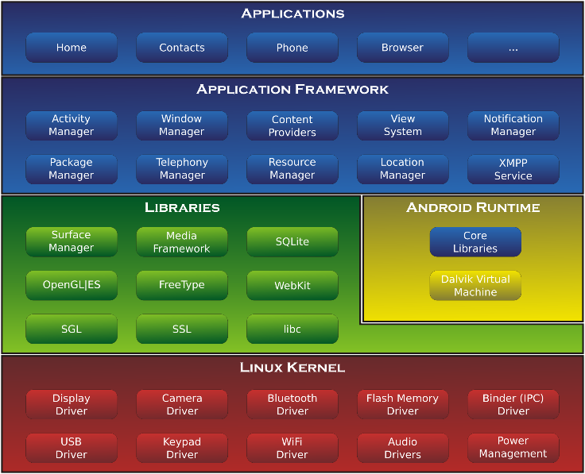
Architecture of

Slide 55
The architecture of a library system

Slide 56
Architectural patterns
Review of several Architectural patterns:
1 - Model-View-Controller (MVC) pattern
2 - Layered architecture pattern
3 - Repository architecture pattern
4 - Client-server architecture pattern
5 - Pipe and filter architecture pattern

Slide 57
3 - Repository architecture pattern
A repository architecture for an IDE

Slide 58
3 - Repository architecture pattern
Sub-systems must exchange data. This may be done in two ways:
Shared data is held in a central database or repository and may be accessed by all sub-systems;
Each sub-system maintains its own database and passes data explicitly to other sub-systems.
When large amounts of data are to be shared, the repository model of sharing is most commonly used a this is an efficient data sharing mechanism.

Slide 59
Repository architecture pattern
Name | Repository
Description | All data in a system is managed in a central repository that is accessible to all system components. Components do not interact directly, only through the repository.
Example | Figure 6.9 is an example of an IDE where the components use a repository of system design information. Each software tool generates information which is then available for use by other tools.
When used | You should use this pattern when you have a system in which large volumes of information are generated that has to be stored for a long time. You may also use it in data-driven systems where the inclusion of data in the repository triggers an action or tool.
Advantages | Components can be independent—they do not need to know of the existence of other components. Changes made by one component can be propagated to all components. All data can be managed consistently (e.g., backups done at the same time) as it is all in one place.
Disadvantages | The repository is a single point of failure so problems in the repository affect the whole system. May be inefficiencies in organizing all communication through the repository. Distributing the repository across several computers may be difficult.

Slide 60
Architectural patterns
Review of several Architectural patterns:
1 - Model-View-Controller (MVC) pattern
2 - Layered architecture pattern
3 - Repository architecture pattern
4 - Client-server architecture pattern
5 - Pipe and filter architecture pattern

Slide 61
A client–server architecture for a film library

Slide 62
4 - Client-server architecture pattern
Distributed system model which shows how data and processing is distributed across a range of components.
Can be implemented on a single computer.
Set of stand-alone servers which provide specific services such as printing, data management, etc.
Set of clients which call on these services.
Network which allows clients to access servers.

Slide 63
Client–server architecture pattern
Name | Client-server
Description | The functionality of the system is organized into services, with each service delivered from a separate server. Clients are users of these services and access servers to make use of them.
Example | Figure 6.11 is an example of a film and video/DVD library organized as a client–server system.
When used | Used when data in a shared database has to be accessed from a range of locations. Because servers can be replicated, may also be used when the load on a system is variable.
Advantages | Servers can be distributed across a network. General functionality (e.g., a printing service) can be available to all clients and does not need to be implemented by all services.
Disadvantages | Each service is a single point of failure so susceptible to denial of service attacks or server failure. Performance may be unpredictable because it depends on the network as well as the system. May be management problems if servers are owned by different organizations.

Slide 64
Architectural patterns
Review of several Architectural patterns:
1 - Model-View-Controller (MVC) pattern
2 - Layered architecture pattern
3 - Repository architecture pattern
4 - Client-server architecture pattern
5 - Pipe and filter architecture pattern

Slide 65
An example of the pipe and filter architecture

Slide 66
5 - Pipe and filter architecture pattern
Functional transformations process their inputs to produce outputs.
May be referred to as a pipe and filter model (as in UNIX shell).
Variants of this approach are very common. When transformations are sequential, this is a batch sequential model which is extensively used in data processing systems.
Not really suitable for interactive systems.

Slide 67
Pipe and filter architecture pattern
Name | Pipe and filter
Description | The processing of data in a system is organized so that each processing component (filter) is discrete and carries out one type of data transformation. The data flows (as in a pipe) from one component to another for processing.
Example | Figure 6.13 is an example of a pipe and filter system used for processing invoices.
When used | Commonly used in data processing applications (both batch- and transaction-based) where inputs are processed in separate stages to generate related outputs.
Advantages | Easy to understand and supports transformation reuse. Workflow style matches the structure of many business processes. Evolution by adding transformations is straightforward. Can be implemented as either a sequential or concurrent system.
Disadvantages | The format for data transfer has to be agreed upon between communicating transformations. Each transformation must parse its input and unparse its output to the agreed form. This increases system overhead and may mean that it is impossible to reuse functional transformations that use incompatible data structures.

Slide 68
For student reVIEW…

Slide 69
Chapter 6-Topics covered
On overview of Architectural design
Architectural views
Architectural patterns
Application architectures

Slide 70
Application architectures
Application systems are designed to meet an organizational need.
As businesses have much in common, their application systems also tend to have a common architecture that reflects the application requirements.
A generic application architecture is an architecture for a type of software system that may be configured and adapted to create a system that meets specific requirements.

Slide 71
Use of application architectures
As a starting point for architectural design.
As a design checklist.
As a way of organising the work of the development team.
As a means of assessing components for reuse.
As a vocabulary for talking about application types.

Slide 72
Examples of application types
Data processing applications
Data driven applications that process data in batches without explicit user intervention during the processing.
Transaction processing applications
Data-centered applications that process user requests and update information in a system database.
Event processing systems
Applications where system actions depend on interpreting events from the system’s environment.
Language processing systems
Applications where the users’ intentions are specified in a formal language that is processed and interpreted by the system.

Slide 73
Application type examples
Focus here is on transaction processing and language processing systems.
Transaction processing systems
E-commerce systems;
Reservation systems.
Language processing systems
Compilers;
Command interpreters.

Slide 74
2 - Transaction processing systems
Process user requests for information from a database or requests to update the database.
From a user perspective a transaction is:
Any coherent sequence of operations that satisfies a goal;
For example - find the times of flights from London to Paris.
Users make asynchronous requests for service which are then processed by a transaction manager.
The structure of transaction processing applications

Slide 75
Software architecture of an ATM system

Slide 76
Information systems architecture
Information systems have a generic architecture that can be organized as a layered architecture.
These are transaction-based systems as interaction with these systems generally involves database transactions.
Layers include:
The user interface
User communications
Information retrieval
System database

Slide 77
Layered information system architecture

Slide 78
Architecture of the MHC-PMS

Slide 79
Web-based information systems
Information and resource management systems are now usually web-based systems where the user interfaces are implemented using a web browser.
For example, e-commerce systems are Internet-based resource management systems that accept electronic orders for goods or services and then arrange delivery of these goods or services to the customer.
In an e-commerce system, the application-specific layer includes additional functionality supporting a ‘shopping cart’ in which users can place a number of items in separate transactions, then pay for them all together in a single transaction.

Slide 80
Server implementation
These systems are often implemented as multi-tier client server/architectures (discussed in Chapter 18)
The web server is responsible for all user communications, with the user interface implemented using a web browser;
The application server is responsible for implementing application-specific logic as well as information storage and retrieval requests;
The database server moves information to and from the database and handles transaction management.

Slide 81
4 - Language processing systems
Accept a natural or artificial language as input and generate some other representation of that language.
May include an interpreter to act on the instructions in the language that is being processed.
Used in situations where the easiest way to solve a problem is to describe an algorithm or describe the system data
Meta-case tools process tool descriptions, method rules, etc and generate tools.

Slide 82
The architecture of a language processing system

Slide 83
Compiler components
A lexical analyzer, which takes input language tokens and converts them to an internal form.
A symbol table, which holds information about the names of entities (variables, class names, object names, etc.) used in the text that is being translated.
A syntax analyzer, which checks the syntax of the language being translated.
A syntax tree, which is an internal structure representing the program being compiled.
A semantic analyzer that uses information from syntax tree and symbol table to check the semantic correctness of the input language text.
A code generator that ‘walks’ the syntax tree and generates abstract machine code.

Slide 84
A pipe and filter compiler architecture

Slide 85
A repository architecture for a language processing system

Slide 86
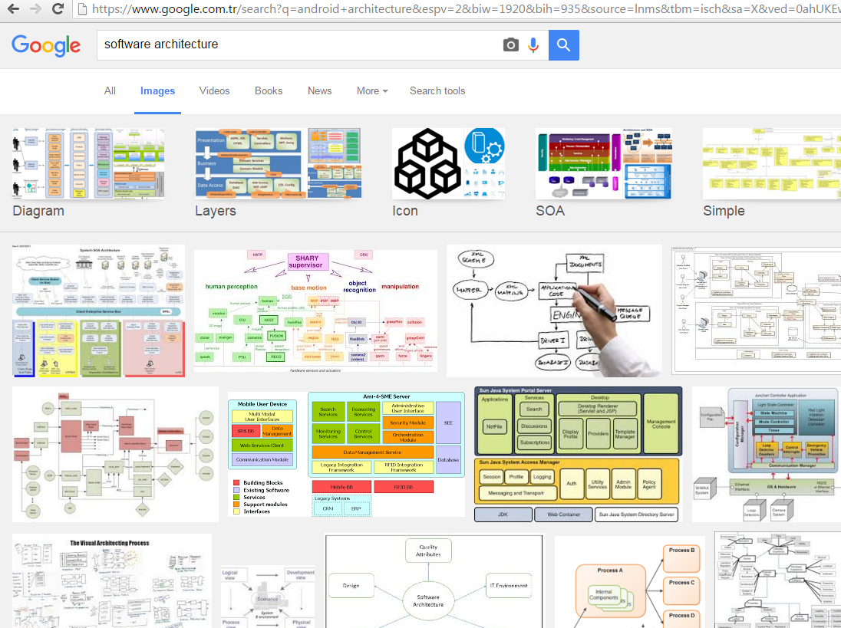
Learn more

Slide 87
Key points
Models of application systems architectures help us understand and compare applications, validate application system designs and assess large-scale components for reuse.
Transaction processing systems are interactive systems that allow information in a database to be remotely accessed and modified by a number of users.
Language processing systems are used to translate texts from one language into another and to carry out the instructions specified in the input language. They include a translator and an abstract machine that executes the generated language.

Slide 88
Use of architectural models
As a way of facilitating discussion about the system design
A high-level architectural view of a system is useful for communication with system stakeholders and project planning because it is not cluttered with detail.
Stakeholders can relate to it and understand an abstract view of the system. They can then discuss the system as a whole without being confused by detail.
As a way of documenting an architecture that has been designed
The aim here is to produce a complete system model that shows the different components in a system, their interfaces and their connections.

Slide 89
Architecture reuse
Systems in the same domain often have similar architectures that reflect domain concepts.
Application product lines are built around a core architecture with variants that satisfy particular customer requirements.
The architecture of a system may be designed around one of more architectural patterns or ‘styles’.
These capture the essence of an architecture and can be instantiated in different ways.
Discussed later in this lecture.

Slide 90
Architecture reuse
Systems in the same domain often have similar architectures that reflect domain concepts.
Application product lines are built around a core architecture with variants that satisfy particular customer requirements.
The architecture of a system may be designed around one of more architectural patterns or ‘styles’.
These capture the essence of an architecture and can be instantiated in different ways.
Discussed later in this lecture.

Slide 91
Advantages of explicit architecture
Stakeholder communication
Architecture may be used as a focus of discussion by system stakeholders.
System analysis
Means that analysis of whether the system can meet its non-functional requirements is possible.
Large-scale reuse
The architecture may be reusable across a range of systems
Product-line architectures may be developed.

Slide 92
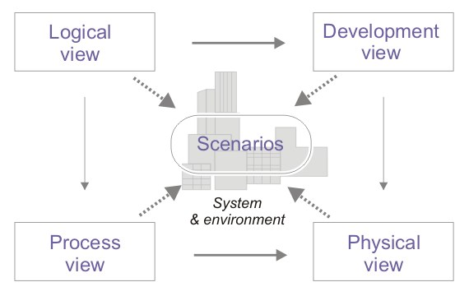
4 + 1 view model of software architecture
functionality that the system provides to end-users
from a programmer's perspective and is concerned with software management
A small set of use cases. Describe sequences of interactions between objects, and between processes.
dynamic aspects of the system, explains the system processes and how they communicate
depicts the system from a system engineer's point of view

Slide 93
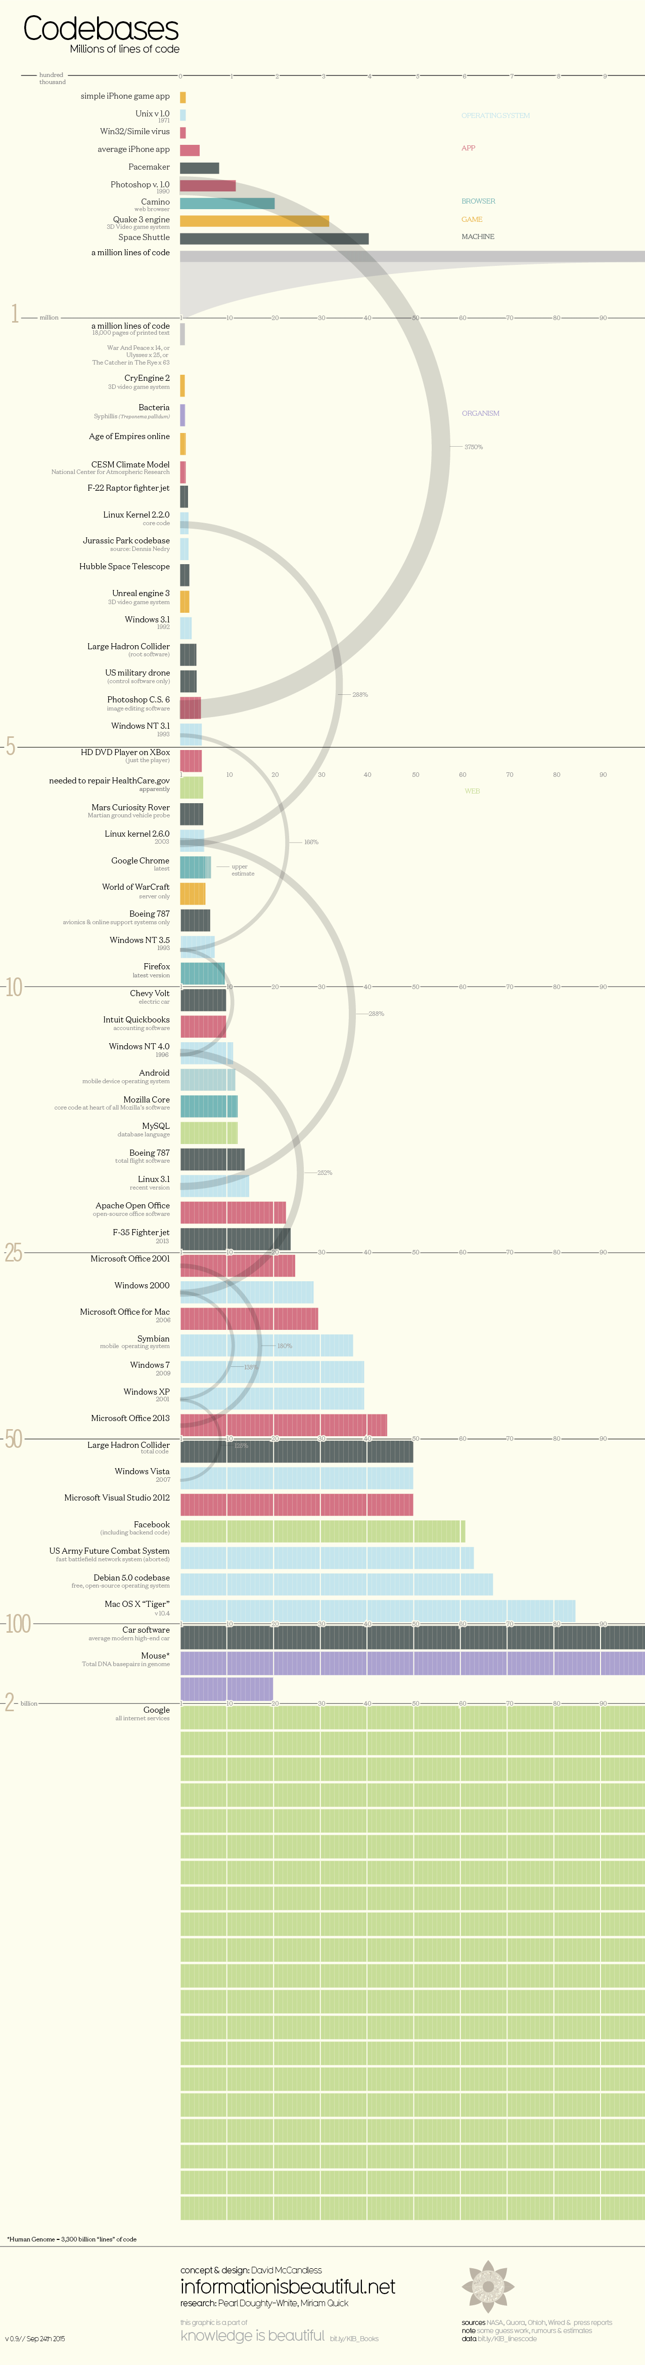
Software sizes

Slide 94
Software sizes

Slide 95
Software sizes

